Slide 1

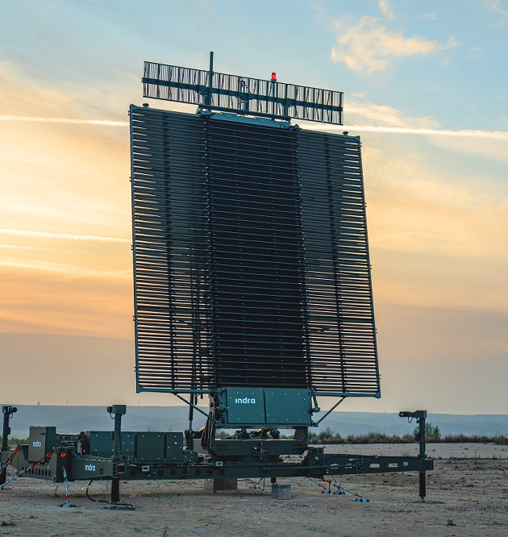
Modern Data Architecture I
Defense Stock Price Analysis
July 22, 2025
Group 4
Alvaro Verona Chirinos, Laura Lopes Vale Estrada De Barros, María Fernanda Hernández Montes, Paula Caceres Cavero, Rawad Yared

Slide 2





The team
Project Team
Alvaro Verona Chirinos
Laura Lopes Vale Estrada De Barros
María Fernanda Hernández Montes
Paula Caceres Cavero
Rawad Yared
Project phase I
The team has completed phase I of the project and is submitting findings related to streaming data ingestion, data storage, and data processing using technologies learned in the program. (further details on the technologies will be outlined next)

Slide 3



Who are INDRA & AIRBUS?
1
INDRA: Indra is one of Spain's leading defense and technology companies. It operates globally across three main
verticals: Defense, Transport & Traffic, and IT
2
AIRBUS: Airbus is a global leader in aerospace and defense, headquartered in Europe. It operates across three main divisions: Commercial Aircraft, Helicopters, and Defense & Space

Slide 4

Purpose of our Analysis
Purpose: Analyze the relationship between news/media sentiment and stock price movements for Airbus and Indra, two key players in Europe’s defense sector to support predictive insights for investors and stakeholders
1
2
Relevance: Both companies are deeply involved in global defense operations, making their stock performance highly sensitive to geopolitical events and public sentiment
3
Indra’s Context: Supplies defense electronics, radar systems, and secure communications to NATO allies; active in conflict zones like Ukraine and the Middle East
Airbus’ Context: Through Airbus Defense & Space, provides military aircraft (Eurofighter Typhoon, A400M), satellites, and cyber defense solutions; integral to European defense responses in recent conflicts (e.g., Ukraine)
4
5
Strategic Importance: Defense contracts and geopolitical tensions drive market perceptions, making sentiment analysis a valuable tool for understanding investor behavior

Slide 5







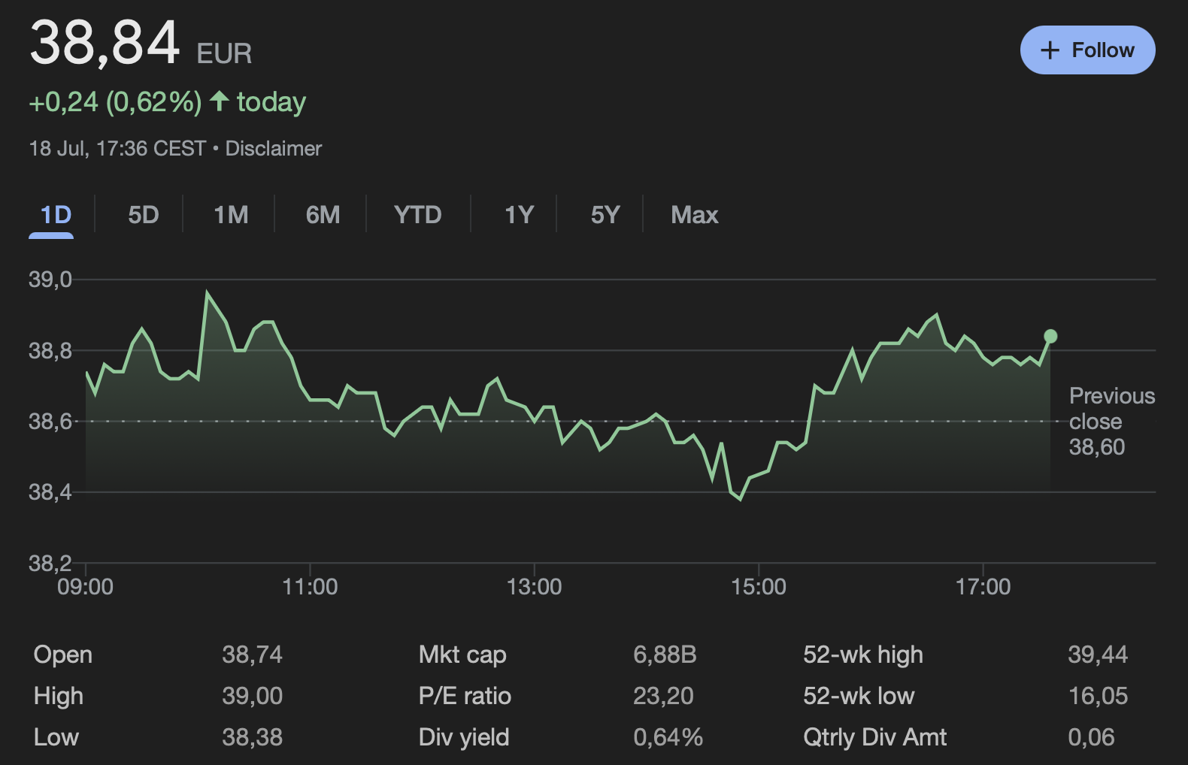
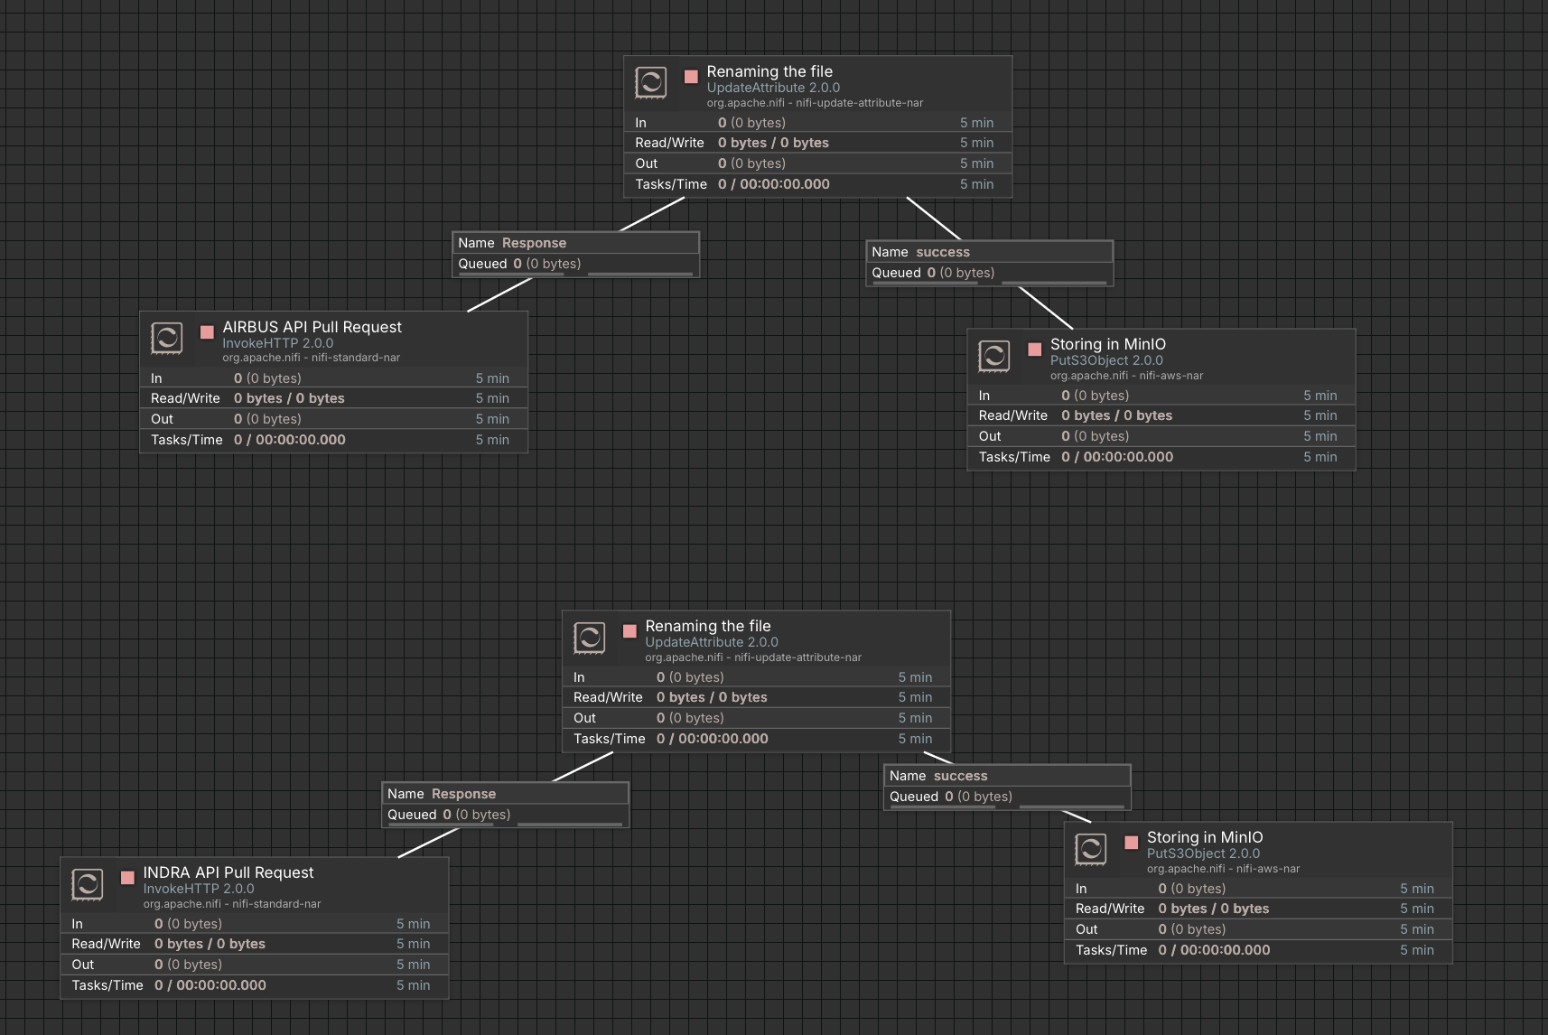
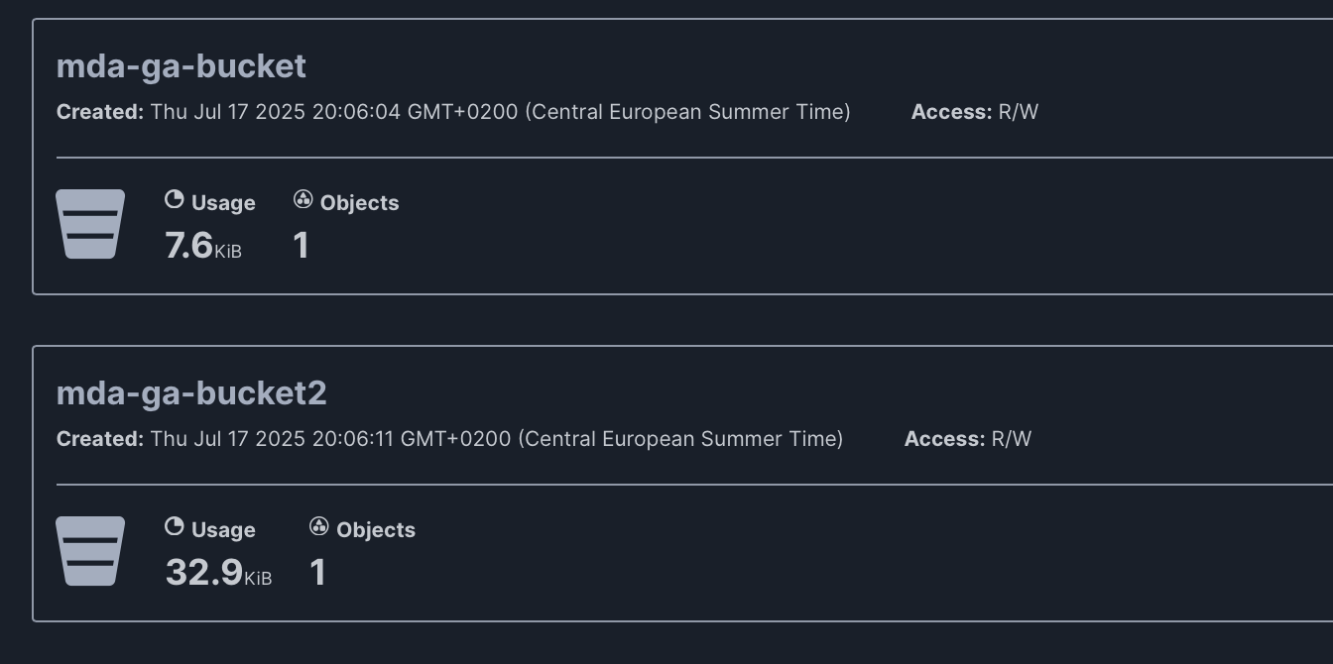
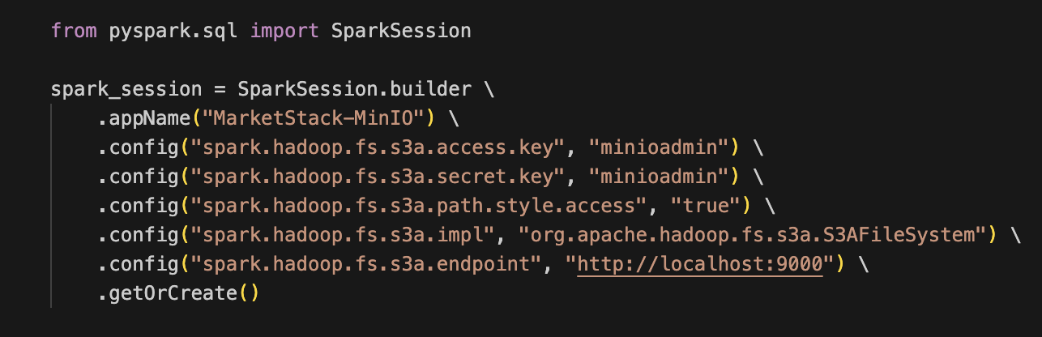
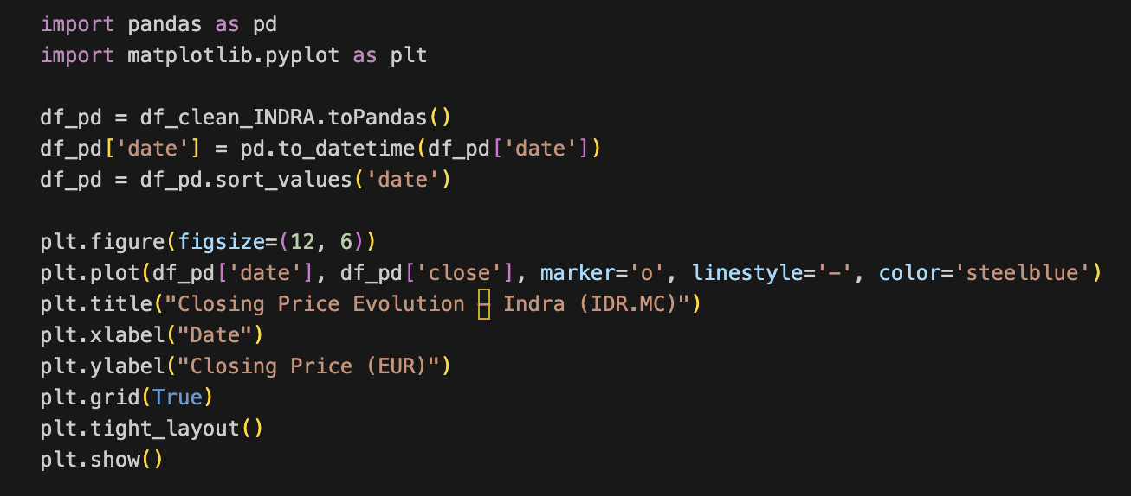
Data Architecture
Data Pipeline / Value Chain
Data Sourcing
Data Ingestion
Data Storage
Data Processing
Data Serving
Technologies
Coming up in phase 2
Pulled daily stock prices via Marketstack REST API
Retrieved news headlines & articles through NewsAPI datasets for sentiment analysis
Built an Apache NiFi flow: InvokeHTTP, UpdateAttribute, PutS3Object
Flow templates were downloaded and can be imported into nifi (note AWS service required)
Provisioned MinIO object store
Created separate buckets for each dataset
Confirmed read/write access for both NiFi processors and Spark jobs
Initiated a spark session
Connected to MinIO
Cleaned data into a data frame using PySpark
Used Vader to conduct sentiment analysis and draw out insights
Description
Loading…
Snapshots

Slide 6


Relevant News & Sentiment Analysis
(June, 19, 2025): "Indra recognized as top-tier European defense integrator in NATO readiness upgrade.” (Bloomberg). This directly positions Indra as a central defense provider. Likely interpreted positively by investors.
(June, 21, 2025): “Pedro Sánchez has informed NATO in a letter that he cannot commit to increasing Spain's defense spending to 5%” (RTVE). A failure to meet NATO spending targets could be perceived as Spain pulling back from defense commitments, potentially making investors nervous about the country's strategic posture and defense-related innovation pipelines just few dates after the first announcement, mitigating the impact of the first news.
Sentiment Spike: Around June 19–20, 2025, there's a strong spike in sentiment, reaching above 0.6.(compound sentiment ≈ +0.6).
Considerations: the Spanish government owns 28% of INDRA's shares.
*The data for sentiment analysis were obtained from NewsAPI, downloaded and processed in a local environment (mac), to obtain a .csv file, which was then uploaded to the VM environment.
*Sentiment analysis was performed using the Vader algorithm plugin in Python, filtering the most relevant news for each company and calibrating the impact to obtain the most significant peaks to simplify the analysis.

Slide 7
Relevant News & Sentiment Analysis
(June, 18, 2025): "Airbus Defence signs new NATO radar surveillance deal worth €300M.” (El Pais)
(June, 20, 2025): "Airbus to ramp up military drone production for Ukraine support.” (DW). These show Airbus is actively engaged in current defense conflicts and securing new contracts. Markets typically reward this.
Sentiment Spike: Multiple positive sentiment spikes in mid to late June — around June 18–20.(sentiment spikes to 0.5+)
Considerations: Investors likely saw these contracts as tangible revenue growth signals, increasing demand for Airbus’ defense tech.
*The data for sentiment analysis were obtained from NewsAPI, downloaded and processed in a local environment (mac), to obtain a .csv file, which was then uploaded to the VM environment.
*Sentiment analysis was performed using the Vader algorithm plugin in Python, filtering the most relevant news for each company and calibrating the impact to obtain the most significant peaks to simplify the analysis.
*In order to use the free NewAPI version, we restrict our analysis in a time frame of 30 days.

Slide 8
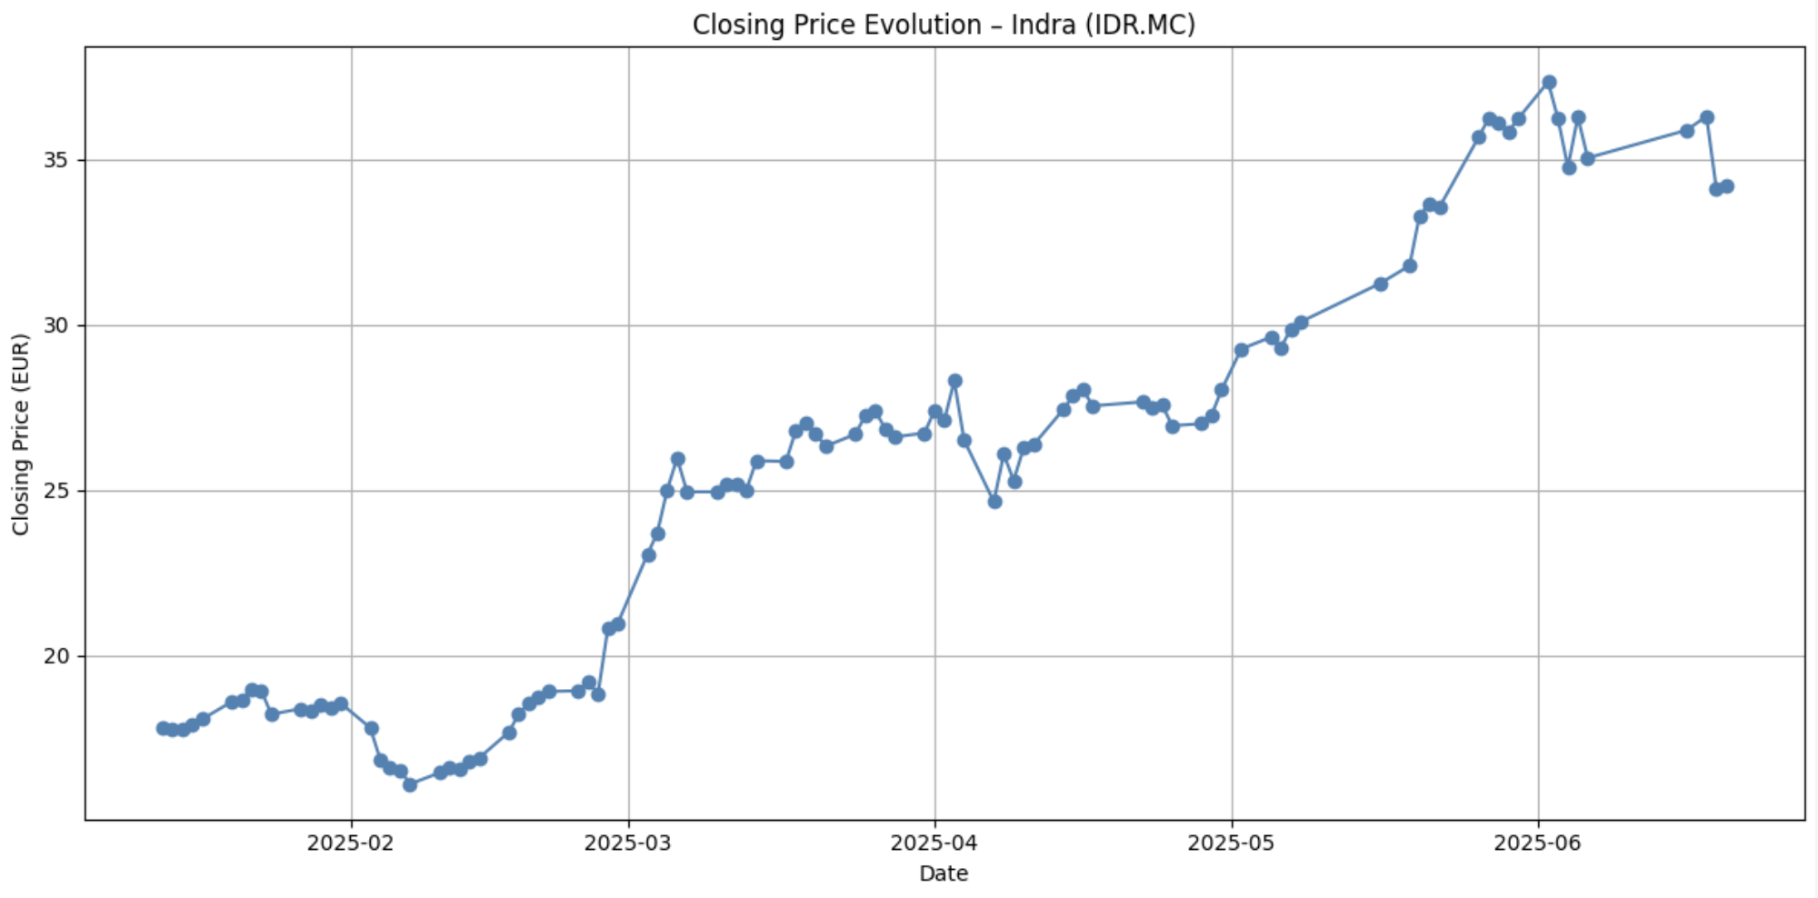
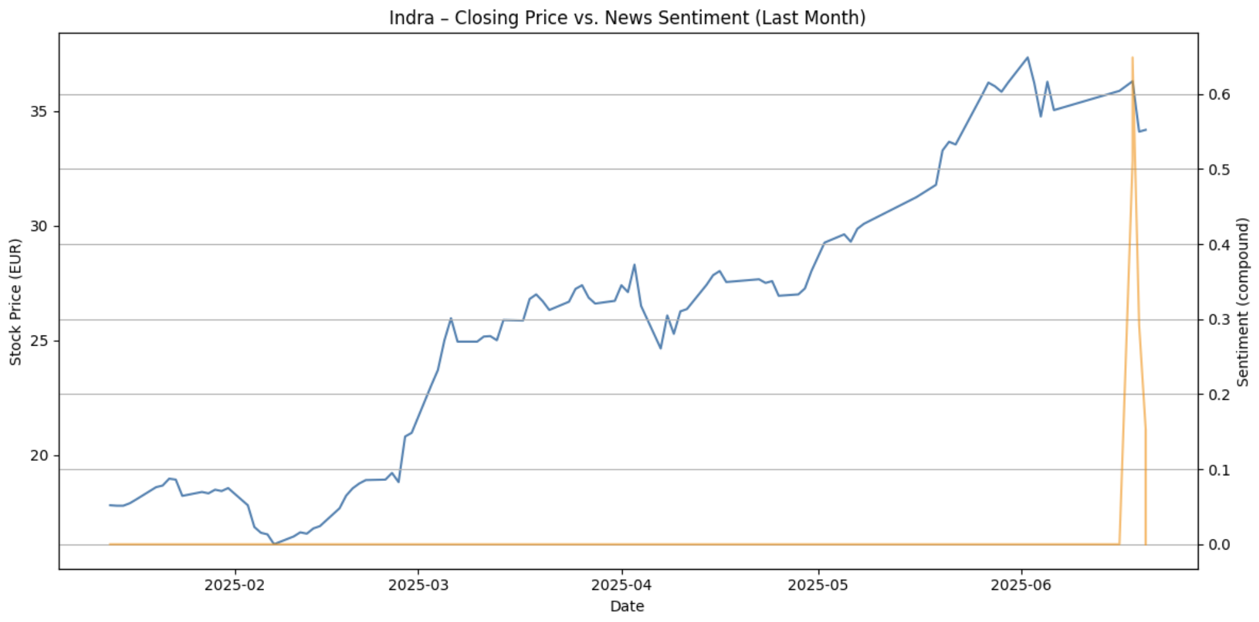
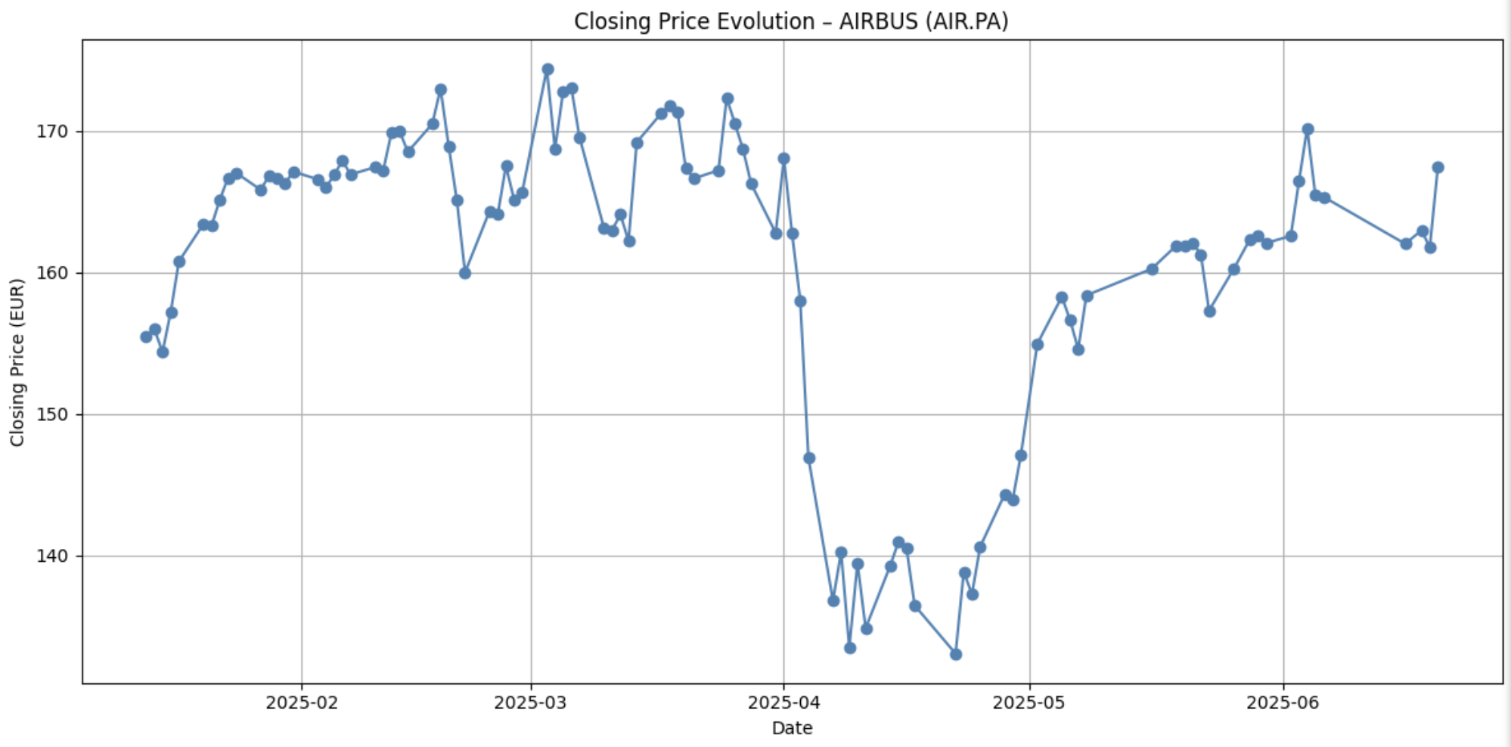
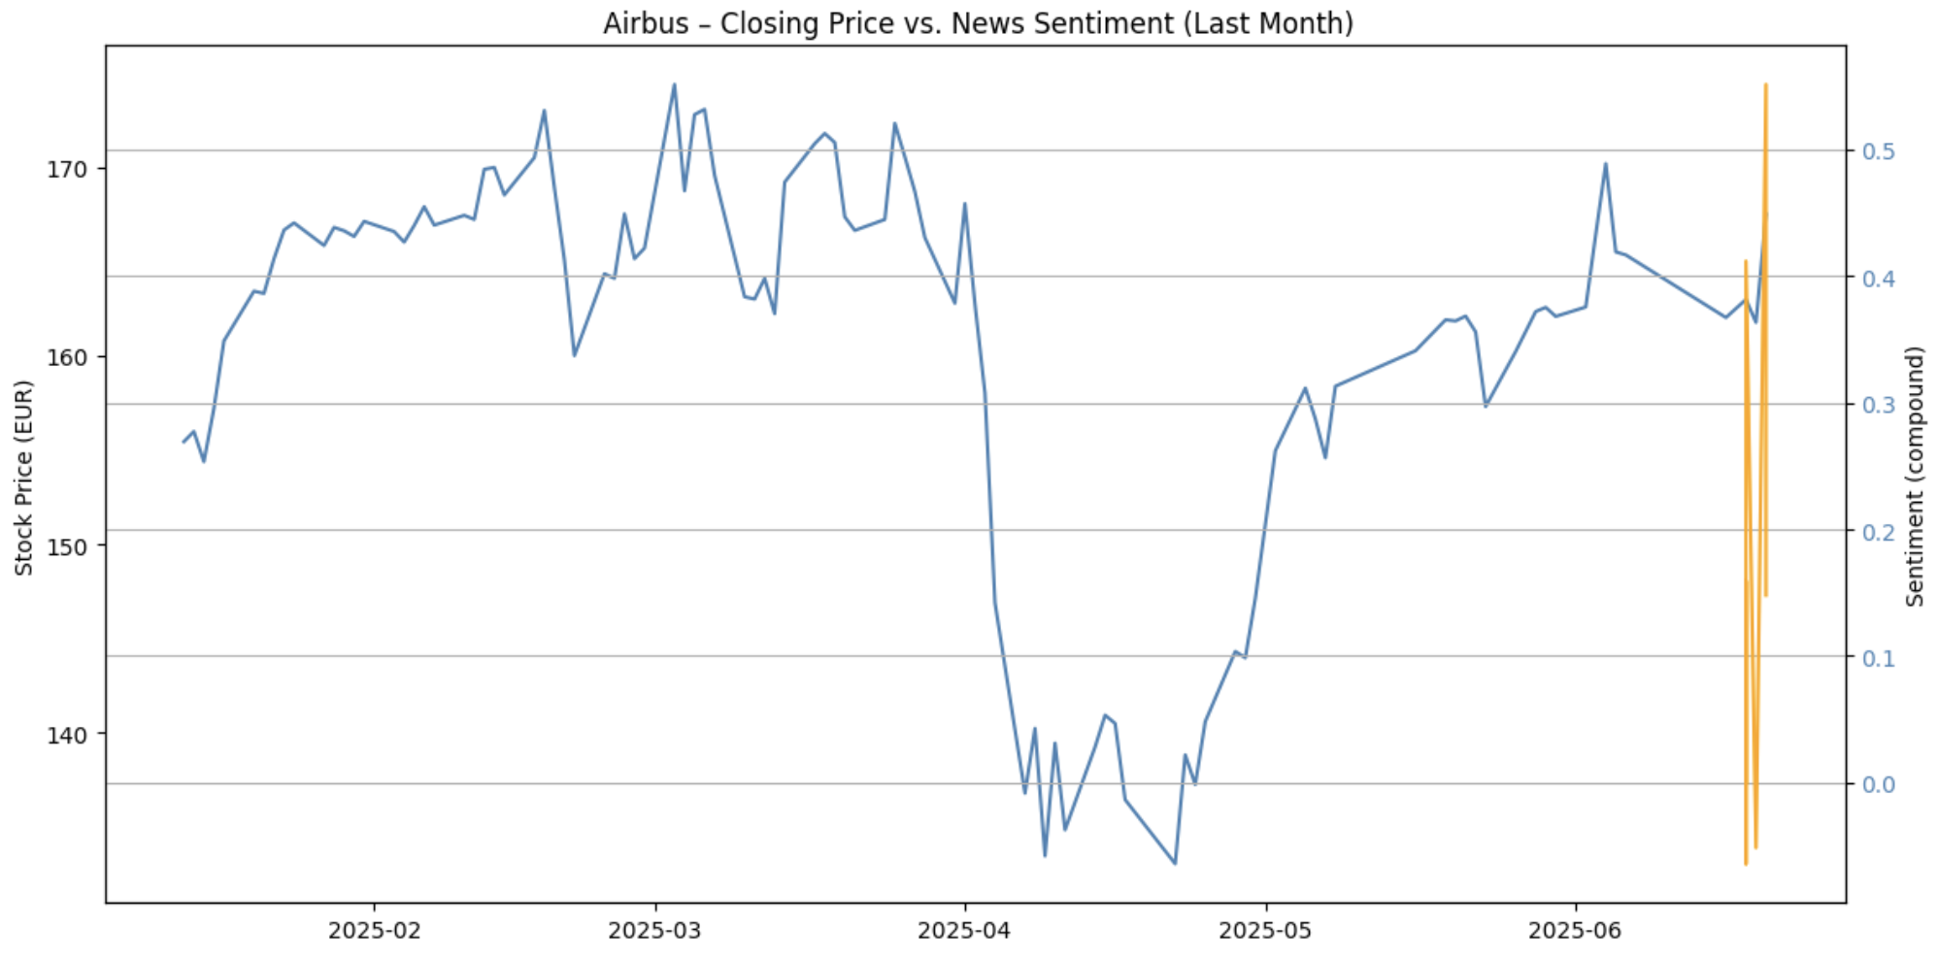
The data was visualized and analyzed using Spark with the following key insights
Data Visualization & Analysis
INDRA Stock Price
Sentiment Analysis
INDRA : While Indra’s price trend was relatively stable before the spike, it shows a downward movement shortly after, suggesting that investors reacted negatively to the recognition. Spike specially related to the Spanish government policy president announcement.
AIRBUS: Support for Ukraine or NATO activities can trigger investor confidence in defense suppliers amid geopolitical instability. These spikes occur while the stock was already recovering, reinforcing momentum. Sentiment linked to military sales or government contracts shows stronger correlation to stock price compared to civilian aviation news.
Key Insights
AIRBUS Stock Price
Sentiment Analysis

Slide 9

Key findings and recommendations were developed in line with the key analysis points
Recommendations
Recommendation 1
Recommendation 2
Recommendation 3
The output of our pipeline can provide us with practical recommendations when deciding our portfolio strategy. In this specific case, we could recommend a short position (sell) in INDRA shares, and a long position (buy or hold) in AIRBUS shares. Of course, this will also depend on each investor's risk aversion and a technical analysis that doesn't contradict our results.
In this industry, special attention should be paid to geopolitical movements when conducting sentiment analysis. This may vary across industries, but fine-tuning the weight given to news of this nature is recommended.
Integrating this analysis with other stock market valuation techniques, the conclusions of our exercise will also depend on each investor's risk aversion and on a robust technical analysis that does not conclude contrary to our analysis.

Slide 10
Considerations & Next Steps
Considerations
External market shocks – Major contract wins, sanctions, or battlefield events can move prices independently of media tone (correlation does not mean causation)
Marketstack free version has a limit of number of pull requests per month so our current ingestion pipeline is limited and not in real time
Next Steps
Add defense-contract award dates, macro indicators (EUR USD, Brent, interest rates), and social-media sentiment to enrich feature set
Upgrade to streaming and near-real-time pipeline so that we can provide event driven recommendations
Build a prediction model using regressors or machine learning models
Integrate machine learning models to refine the sentiment analysis factor by company/industry.

Slide 11

Thank You

